Slide 1

Pedestrian Crossing Detection using Mobile Devices
FACULTY OF AUTOMATION AND COMPUTER SCIENCE
COMPUTER SCIENCE DEPARTMENT
Graduate: Horațiu - Laurențiu IACOȘ
Supervisor: Assist. Prof. Dr. Eng. Florin ONIGA

Slide 2
Motivation
Context: Detecting sudden pedestrian crossings to assist drivers in avoiding accidents therefore minimizing both material and human casualties.
Motivation factors:
Addressed problem has great social meaning and application value.
Important application in robot vision and intelligent vehicle research.
Special requirements that make it different from existing related research.
Make such systems be easily available and accessible.

Slide 3
Objectives
Develop an autonomous system capable of classifying and identifying pedestrian crossing markings on the road surface.
Provide a performant and robust algorithm capable of running on mobile devices using images captured by the device camera.
Provide real time feedback to the driver based on the detection results.

Slide 4
Related work
Several different approaches are currently available, few of which are intended to run on mobile devices.
Approaches relate to:
Feature extraction using edge detection and line transform [1]
Region extraction using bipolarity constraint [2]
Periodicity property using projective invariants [3]

Slide 5
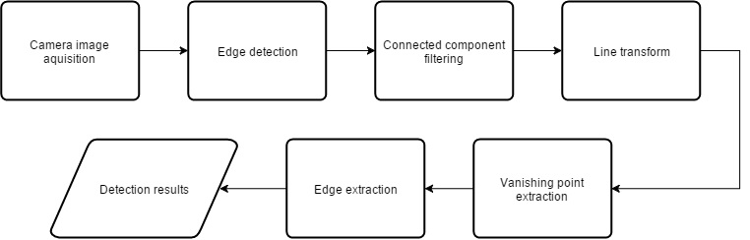
Detection algorithm

Slide 6
Detection algorithm (cont'd)
Steps:
Original image
Grayscale conversion
Canny edge detection
Morphological dilation
Morphological erosion
Connected component filtering
Hough line transform
Vanishing point extraction
Edge extraction

Slide 7
Detection algorithm: Canny edge detection
Pre-processing: Grayscale conversion
Reduce the amount of data in the image while keeping the structural information for processing.

Slide 8
Detection algorithm: Connected component filtering
Pre-processing: Morphological closing operation used to join close edges.
Used to eliminate elements from the image that do not satisfy the set of conditions related to:
Size: Candidate surface area is too small or too large to be a crossing segment
Geometric feature: Candidate fill-ration is over or under a threshold value
Purpose: reduce the amount of data for the next step of the algorithm.

Slide 9
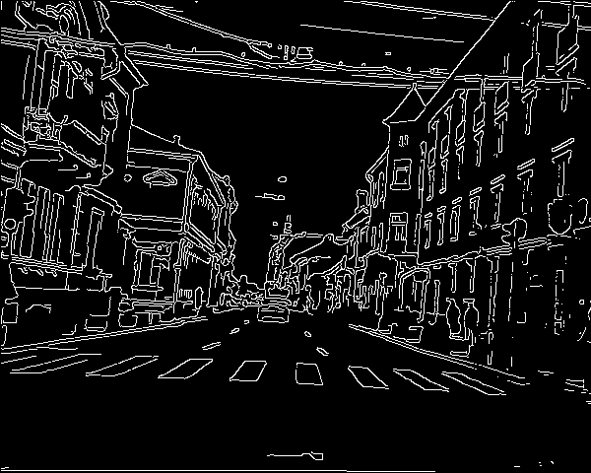
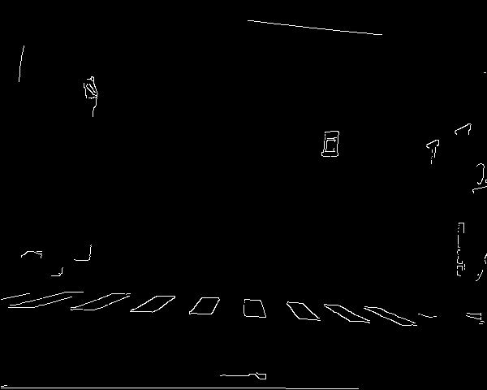
Detection algorithm: Connected component filtering (cont'd)

Slide 10
Detection algorithm: Hough line transform
Pre-processing: Edge detection
Used to detect straight lines in an image using a voting procedure where individual lines are represented in an accumulator using the Polar coordinate system.

Slide 11
Detection algorithm: Vanishing point extraction
Pre-processing: Line transform
Represented by a point, where projections of parallel lines converge in the image plane.
Purpose: Filter and extract the set of lines that intersect in the vanishing point.

Slide 12
Detection algorithm: Edge extraction
Pre-processing: Vanishing point line extraction
Used to extract and partition the set of line segments where the intensity variation follows a transition from light-to-dark and dark-to-light.
Purpose: Increase accuracy while eliminating false sets of parallel structures.

Slide 13
Implementation details
Target environment: Android mobile operating system
Popular, open-source, versatile
High end devices
Real time processing:
Native implementation using C/C++ for image processing tasks
Java implementation for the rest of the environment
Development environment
DIBLook framework under Visual Studio
Android Development tools and Android NDK under Eclipse

Slide 14
Results
Detection:
Detection tested on a wide set of images with 20 different intersections
Detection distance up to ~8-10 meters with an accuracy of 78% within specified distance
False positive induced on low quality markings
Performance:
Processing time for a 860x480 image resolution ~30ms / frame, using an Intel core i7 processor with a clock frequency of 2.30 Ghz
Processing time for the same resolution ~90ms / frame, using a mobile Qualcomm Snapdragon 805 processor with a clock frequency of 2.70 Ghz

Slide 16
Future development
Optimizations and increased detection range
Thermal throttling of the processor
Self-adjusting horizon line position
Improved user interface
Application distribution
Android Wear integration

Slide 17
Conclusions
The algorithm was proved to have a high recognition rate in pedestrian crossing detection
The proposed solution is capable of running on mobile devices within acceptable detection rates
Real-time feedback of the detection is delivered to the driver

Slide 18
Bibliography
[1] Zebra-crossing Detection for the Partially Sighted, Stephen Se, Department of Computer Science, University of British Columbia Vancouver, B.C. Canada V6T 1Z4
[2] An Image Based Detection of Pedestrian Crossing, Cao Yuzhen, Chen Lushi, Jia Shuo, Dept. of Biomedical Engineering, School of Precision Instrument and Opto-Electronics Engineering, Tianjin University, 92 Weijin Road Tianjin, China, 00072
[3] Detection of pedestrian crossings with projective invariants from image data, Tadayoshi Shioyama and Mohammad Shorif Uddin, Department of Mechanical and System Engineering, Kyoto Institute of Technology, Matsugasaki, Sakyo-ku, Kyoto 606-8585, Japan, 19 November 2004

